Slide 1
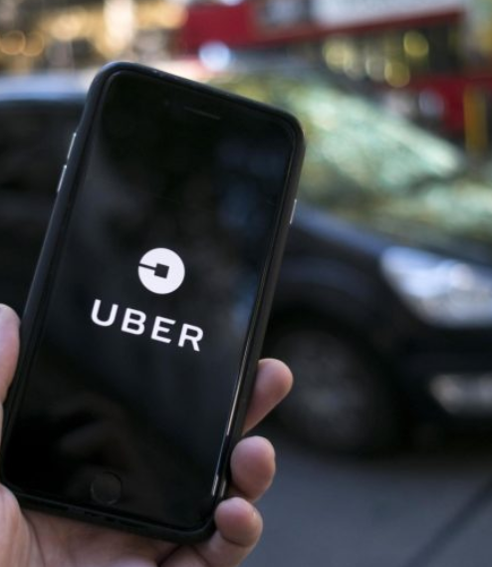
Uber Trip Analysis
A Rishi
A Raghu
Ch Nithin Reddy

Slide 2
Contents
Problem Statement
&
Introduction
Existing System
&
Proposed System
Software and Hardware
Modules Involved In The Project
Conclusion
Presentation Title

Slide 3
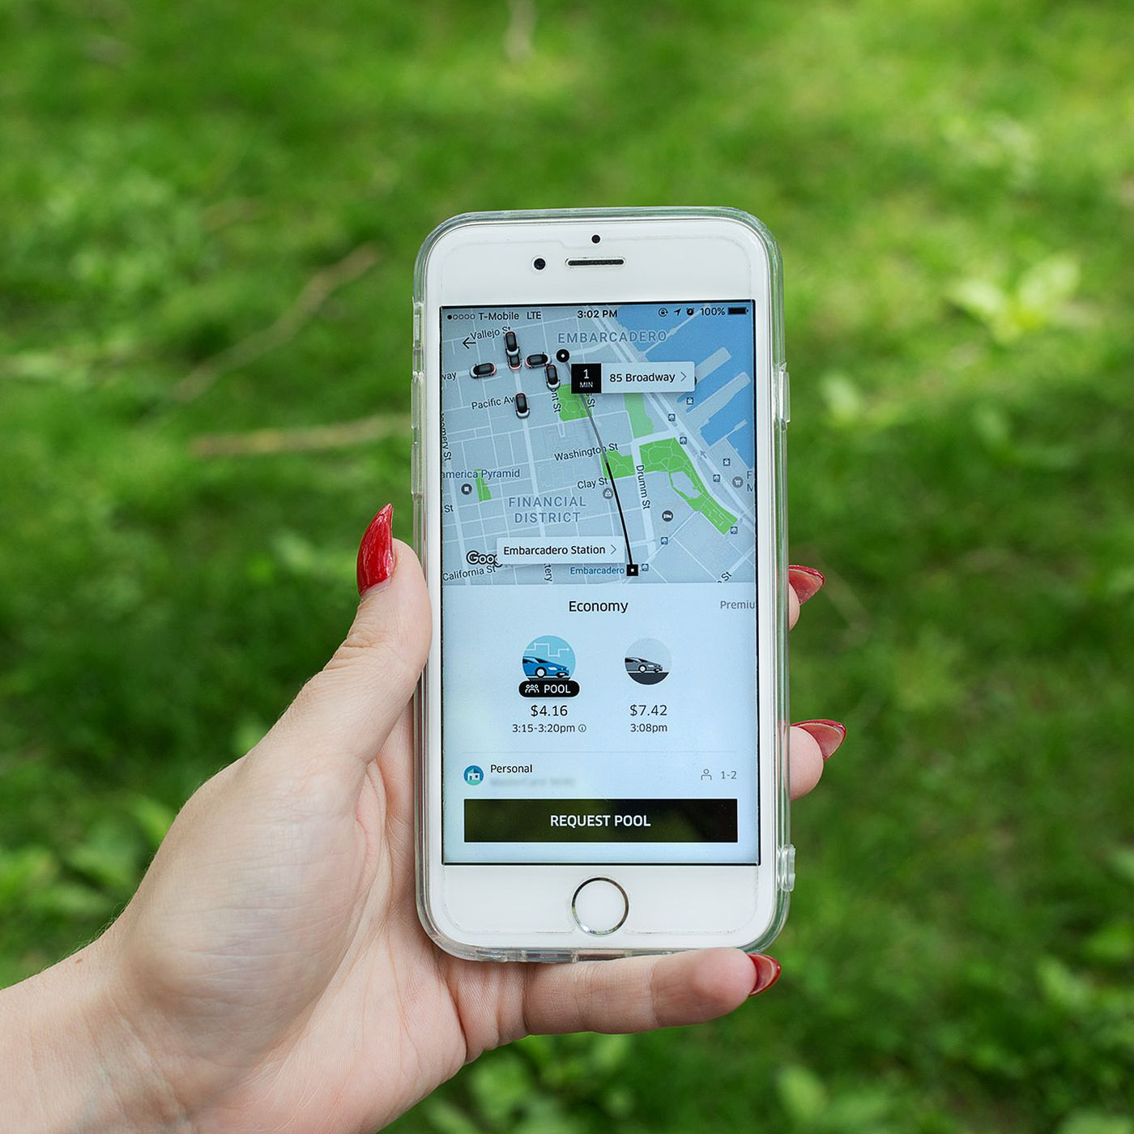
Problem Statement
The Uber trip data from a large city in the United States is analyzed in this study.
Utilizing machine learning techniques and libraries to detect patterns and trends in rider behavior.
The data set contains information on pick-up and drop-off locations and other important aspects.
The data was cleaned and preprocessed using the Pandas and NumPy tools.
Overall, this study uses machine learning approaches to give important insights on the patterns and trends in Uber journeys.

Slide 4

Introduction
Uber is a ride-sharing platform that operates in over 900 cities worldwide.
Uber trip analysis using machine learning involves identifying patterns and trends in rider behavior, including pick-up and drop-off locations, time of day, day of the week, and trip duration.
This analysis can help Uber improve its services by identifying areas with high demand and improving rider wait times.
This will start from data collection and after collecting it cleaned and preprocessed and send it to the model to learn or fit to it. We made final predictions on the basis of the data which we fed to it.

Slide 5
Existing System
Machine learning Uber Trip Analysis algorithms are widely used today, several existing systems for Uber trip analysis are given below: Number of trips per day/week/month Average trip duration and distance Rider ratings of drivers Driver ratings of passengers Expenses for vehicle maintenance and fuel Number and reasons for canceled trips Fraudulent activities and incidents

Slide 6
Proposed System
Proposed system for Uber trip analysis could involve collecting and analyzing various data points related to trips taken by Uber users. This could include factors such as pick-up and drop-off locations, time of day, distance traveled, trip duration, and fare charged. To implement such a system, We could utilize machine learning algorithms and data visualization tools to identify patterns and trends in the data. For example, the system could analyze data to determine which pick-up and drop-off locations are most frequently requested, which times of day have the highest demand, and which routes are most commonly taken by riders. Overall, a proposed system for Uber trip analysis would involve collecting and analyzing data to identify patterns and trends, and then using that information to optimize Uber's operations and improve the user experience. This could lead to increased efficiency, more satisfied customers, and ultimately, higher profits for Uber.

Slide 7
Software and Hardware
Software: To analyze Uber trips, you would need both software and hardware software. Programming Language: Machine Learning. Machine Learning Libraries: Numpy, Pandas, Classification Algorithms Data Visualization Libraries: Matplotlib, Seaborn. Integrated Development Environment(IDE): Jupyter Notebook or Google Colab

Slide 8
Software and Hardware
Hardware: Computer Operating System: Windows, Mac OS and Linux. RAM: At least 8gb of RAM is recommended, but 16gb RAM is good for large datasets. Processor: a clock speed of 2.5GHz Storage/ Memory: At least 512gb is recommended. Graphic Card: At least 2GB of VRAM is needed.

Slide 9
Modules Involved In The Project
The several libraries or modules are used in this Uber Trip Analysis project. Some of them are given below: Numpy: A python library used for scientific computing. Pandas: A python library used for data analysis and manipulation. Matplotlib: A python library used for data visualization, including scatter plots, and bar graphs.

Slide 10
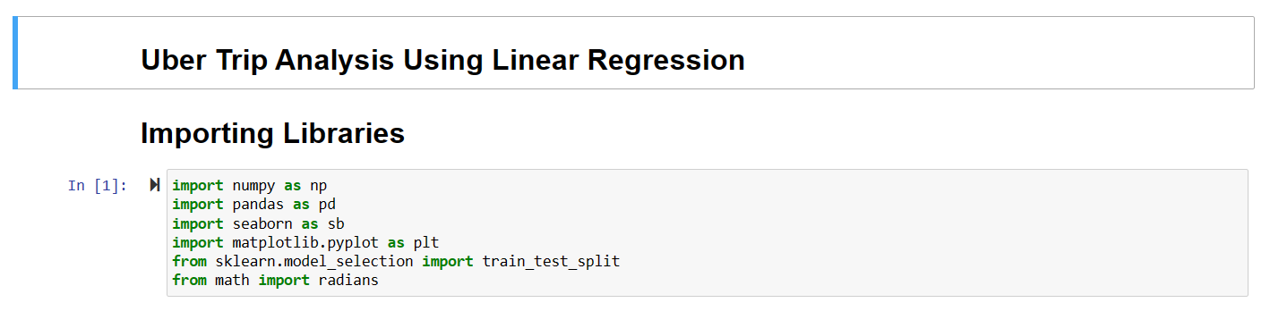
Architecture

Slide 11
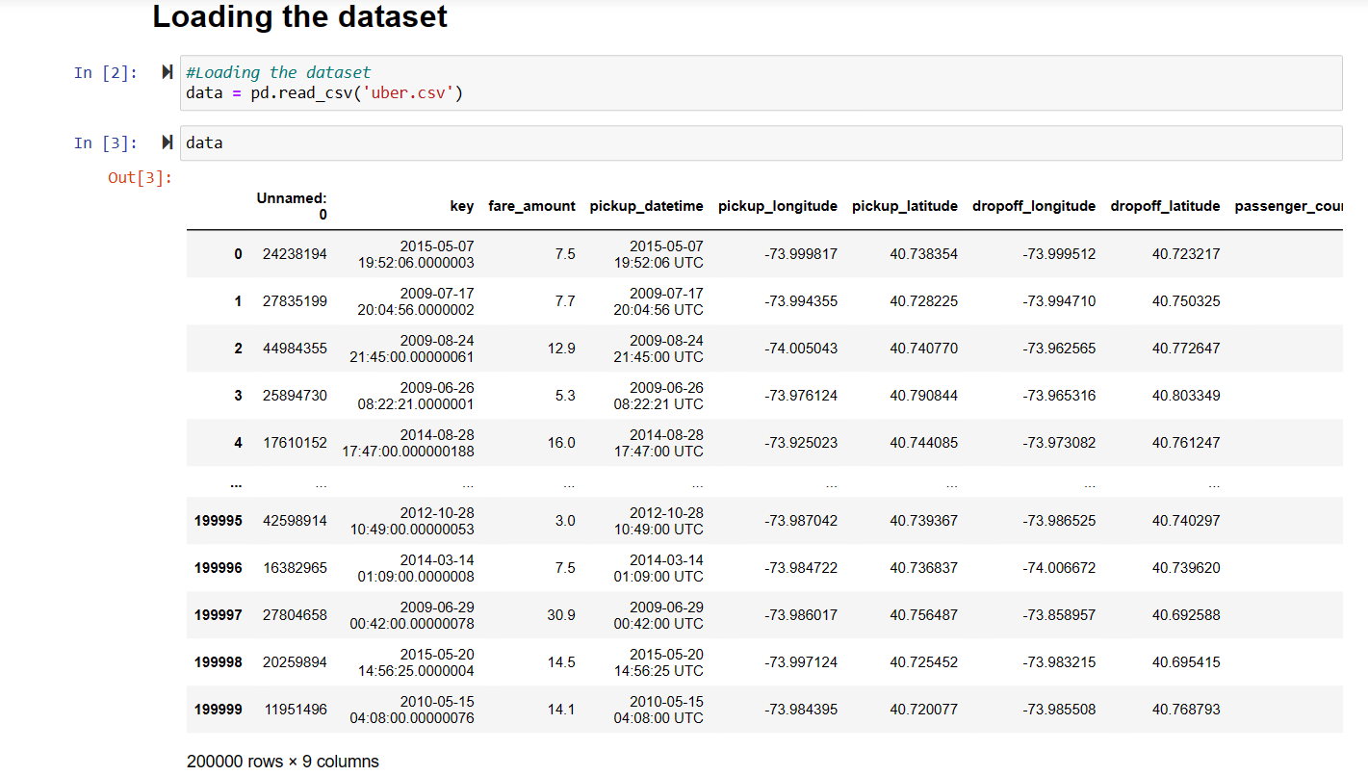

Slide 12
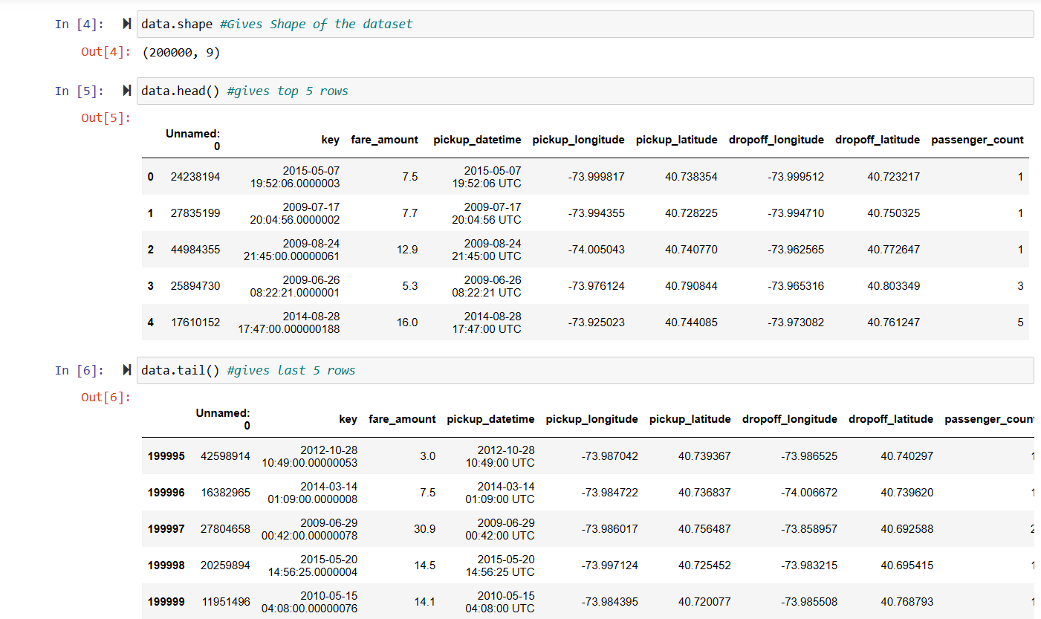

Slide 13
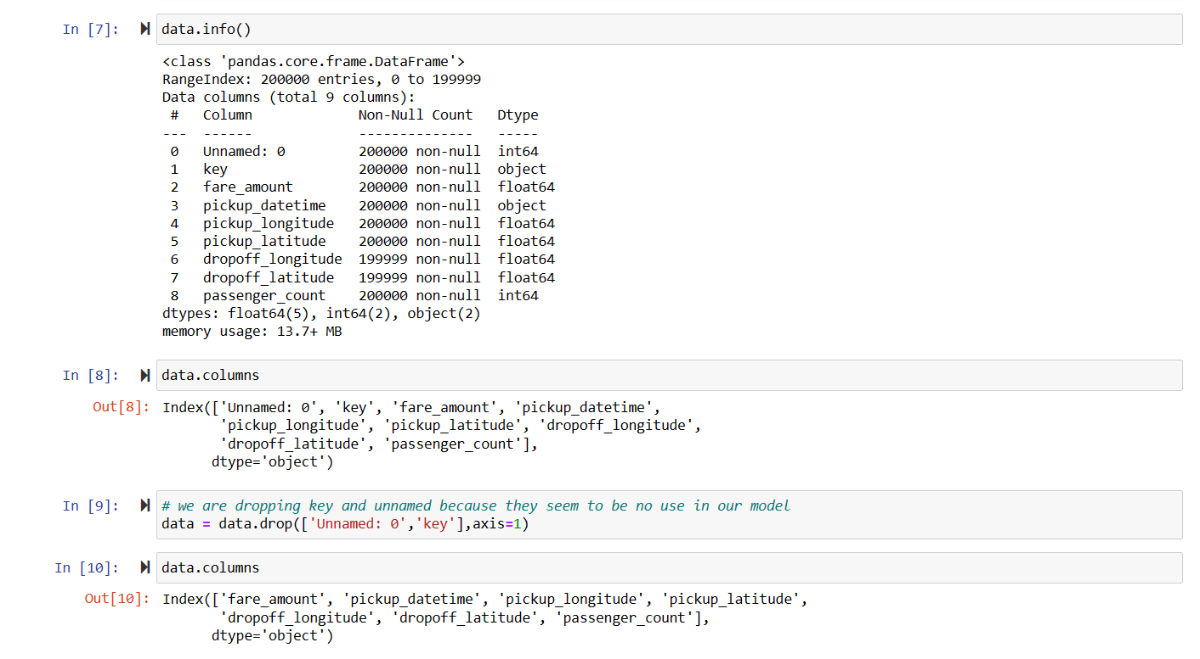

Slide 14
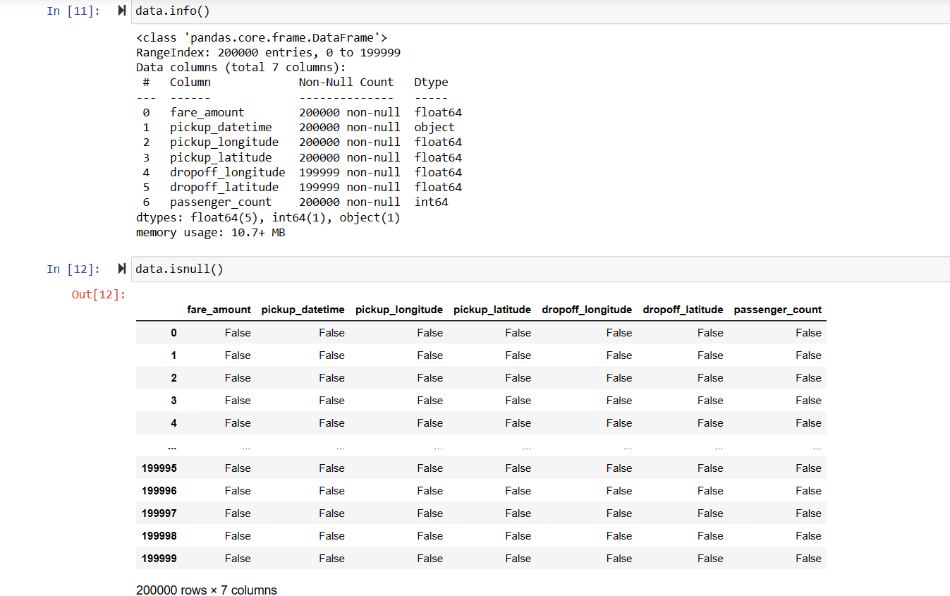

Slide 15
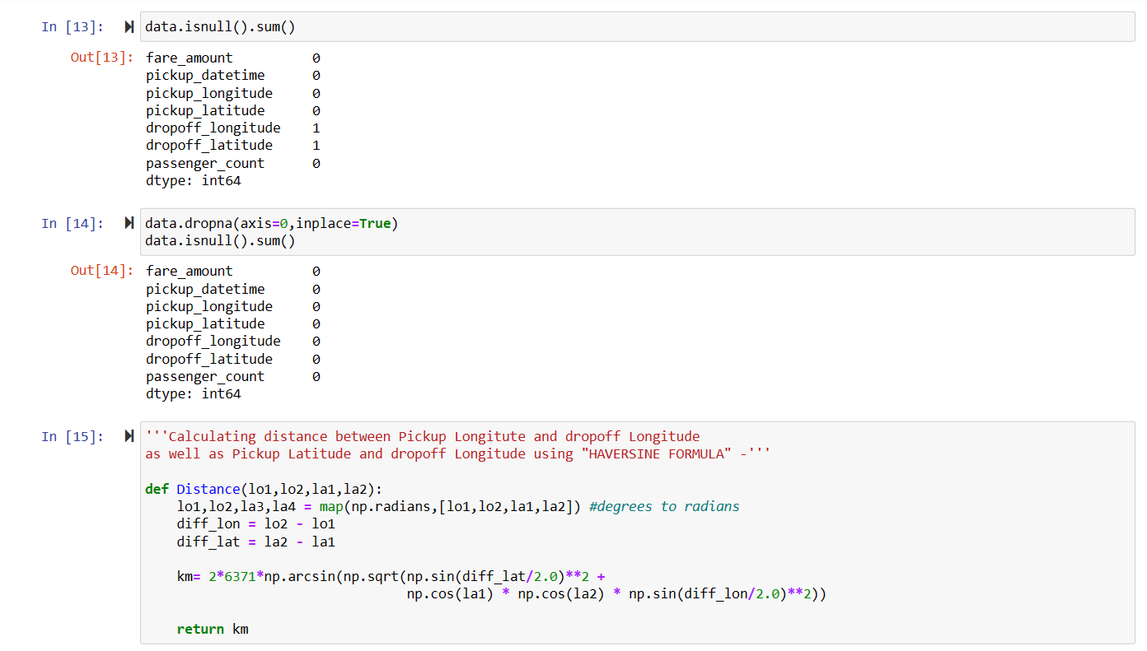

Slide 16
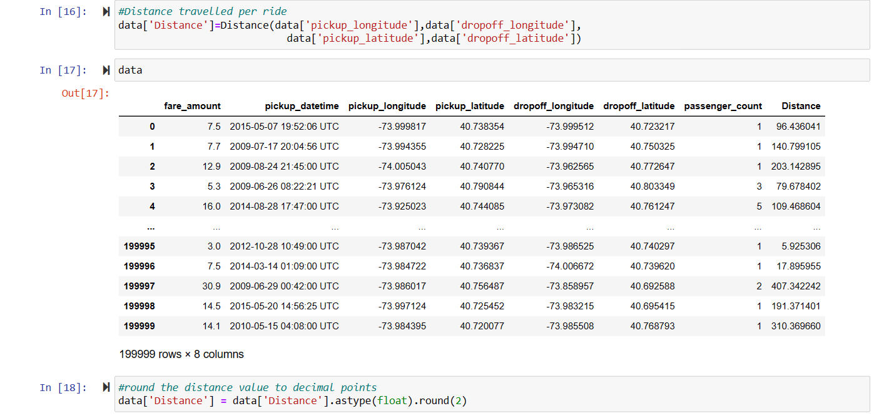

Slide 17
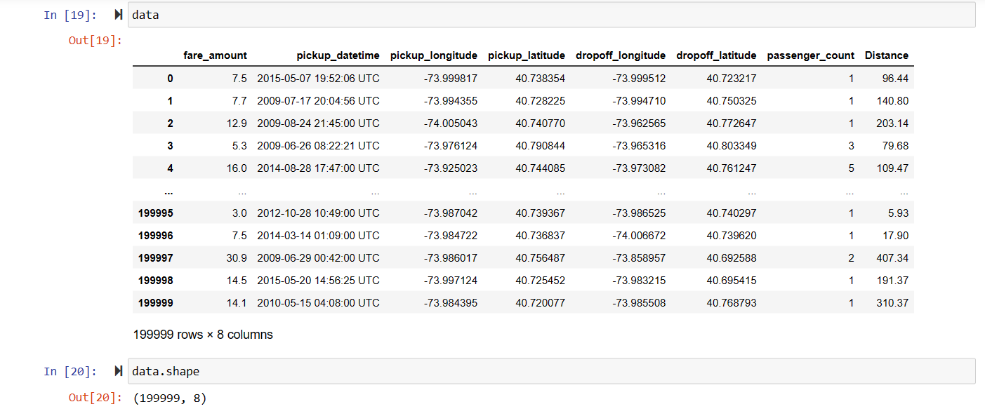

Slide 18
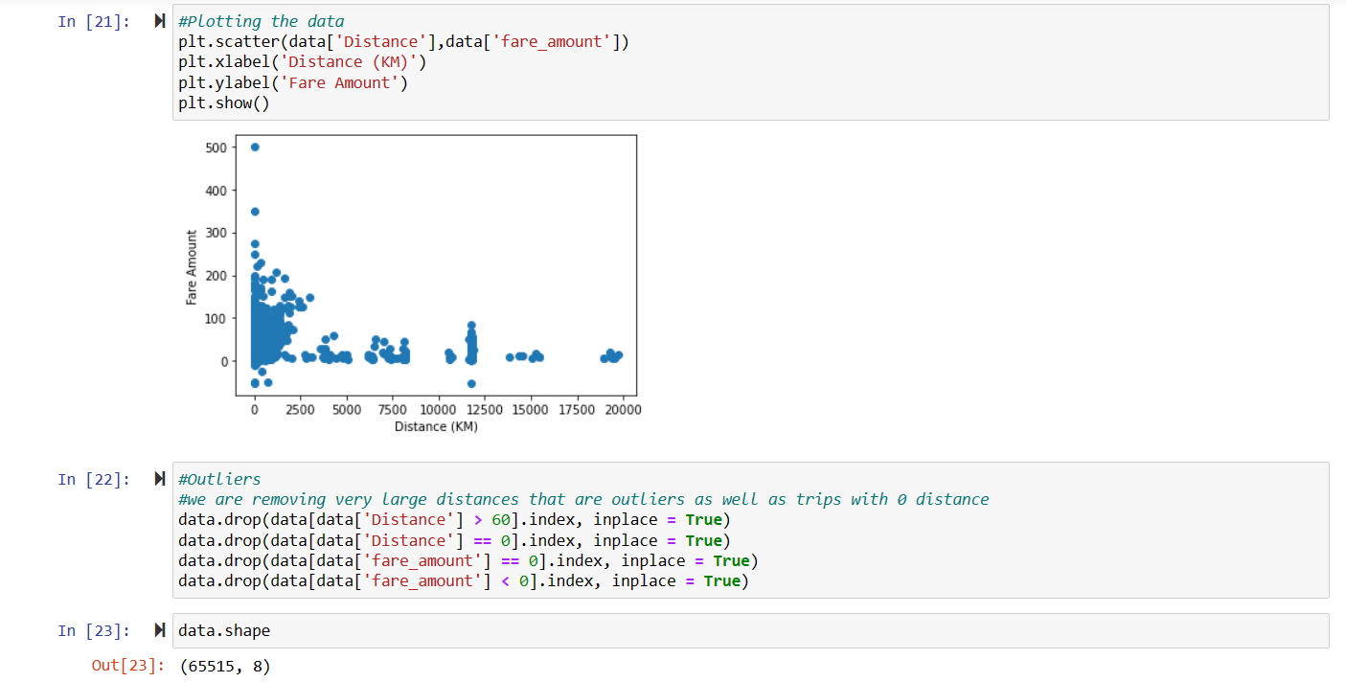

Slide 19
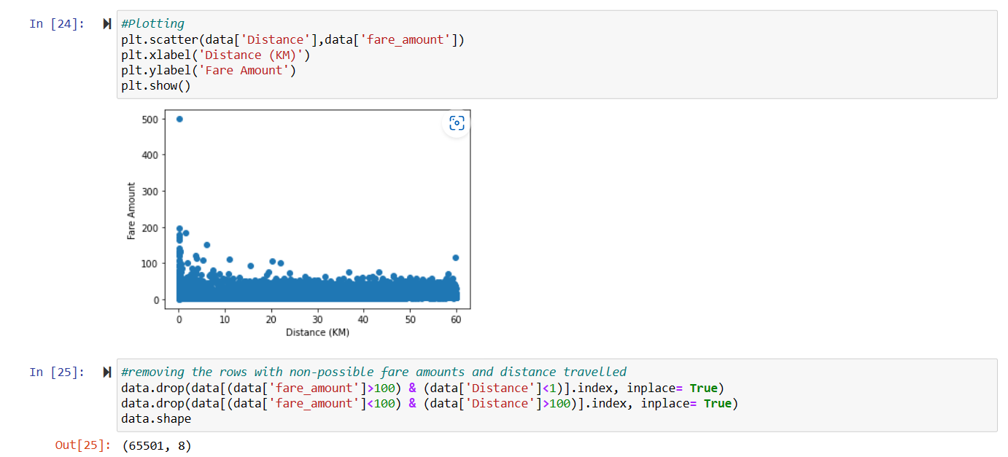

Slide 20
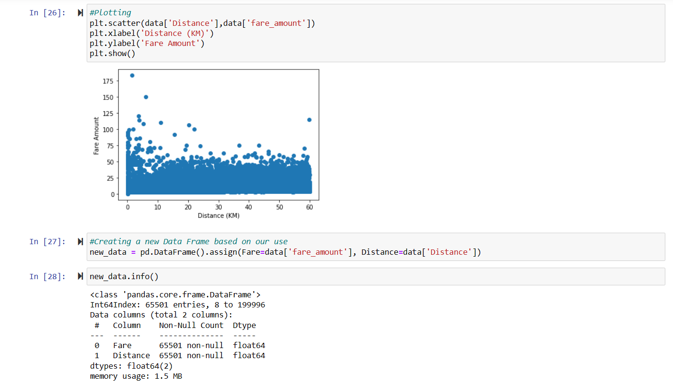

Slide 21
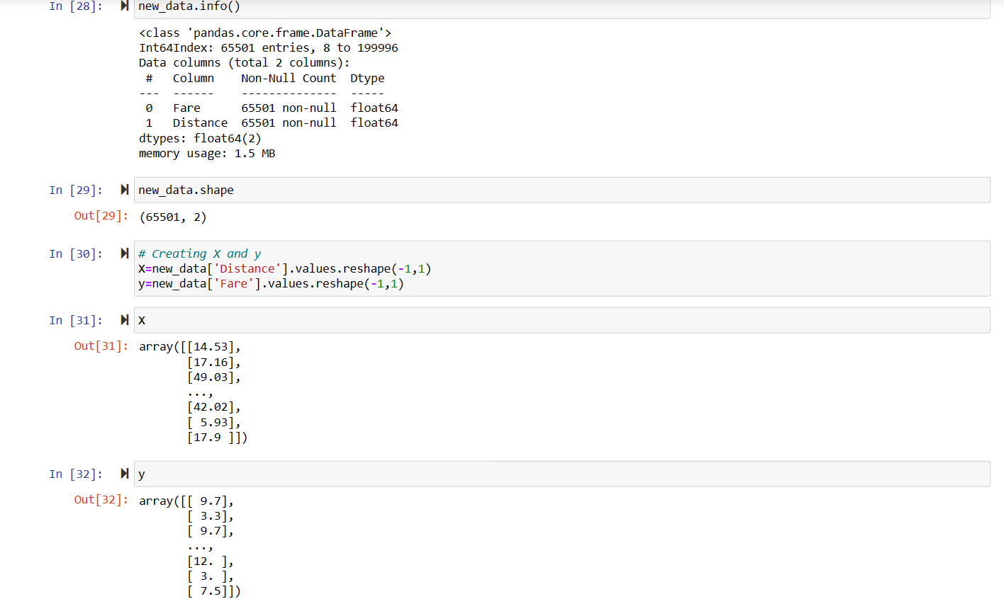

Slide 22
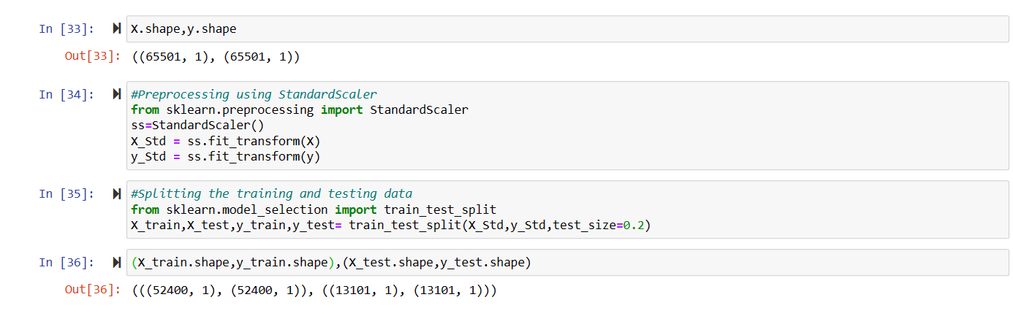

Slide 23
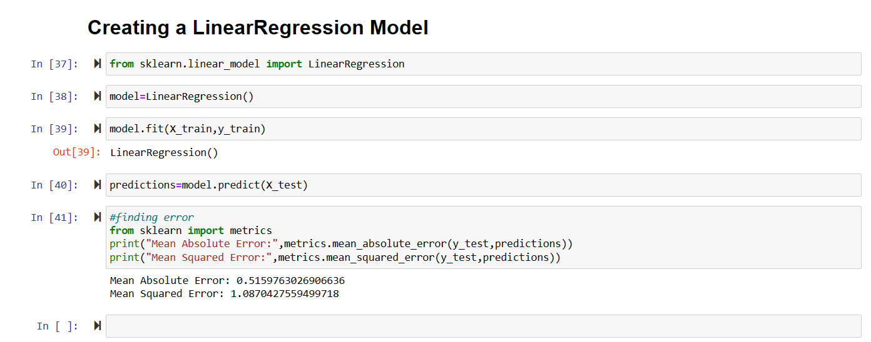

Slide 24
Conclusion
In conclusion, Uber trip analysis has the potential to provide valuable insights into travel patterns and behavior. By collecting and analyzing data, analysts can identify trends and patterns that can inform decision-making and improve the overall user experience. However, there are also challenges and limitations to consider, such as ensuring data accuracy. Despite these challenges, the potential benefits of Uber trip analysis make it a valuable tool for improving the ride-sharing experience. Finally we will build a Machine Learning model which on the basis of the data of Uber Trips. This model will predict the money based of the distance travelled.

Slide 25

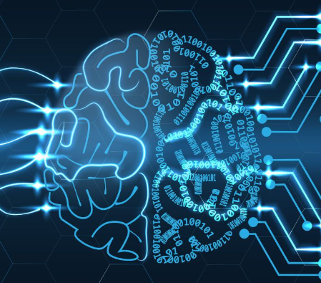

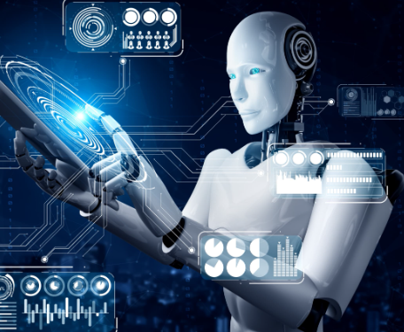
Thank you
A Rushi (20ME2A5403)
A Raghu (20ME1A5405)
Ch Nithin Reddy (20ME1A5409)

